Slide 1
Army Leadership and Education
ACTE Leadership Training Program
3 March 2013

Slide 2
Core Army Values
The Army foundation is its Army Values.
The Army Values define who we are, what we do, and for what we stand.
The Army Values assist Soldiers to develop a moral compass that guides them to make the right moral and ethical decisions
L-D-R-S-H-I-P
Loyalty: Bear true faith and allegiance to the U.S. Constitution, the Army, your unit, and other soldiers.
Duty: Fulfill your obligations.
Respect: Treat people as they should be treated.
Selfless Service: Put the welfare of the nation, the Army, and your subordinates before your own.
Honor: Live up to all the Army values.
Integrity: Do what's right, legally and morally.
Personal Courage: Face fear, danger, or adversity (physical or moral).
Notes:
Jobs requiring STEM degrees are projected to increase four times as fast as overall job growth. Many job openings will not be filled by United States citizens (BHEF 2005). Foreign STEM graduates are working less in the United States due to increased immigration regulations and increased resources in their countries of origin.
K-12 students from the United States perform below students from other industrialized countries on international tests of math and science. In the report issued Dec. 4, 2007 by the Organization for Economic Cooperation and Development, the US was classified as “statistically below OECD average” in both science knowledge and mathematics in the 2006 PISA survey of 400,000 15-y.o. students in 57 countries!
Within the U.S., there is an achievement gap between under-represented minority students and majority students at a time when underrepresented groups are becoming an increasing proportion of the national labor force.
Less than 40% of students intending to major in STEM fields upon college entrance actually complete a degree in these fields. For underrepresented minorities the rate is below 25%.
Internationally the US has far fewer STEM graduates compared to other industrialized countries.
U.S. advantages in the marketplace and in science and technology have begun to erode. A comprehensive and coordinated federal effort is urgently needed to bolster U.S. competitiveness and pre-eminence in these areas. [We make] four recommendations along with 20 implementation actions that federal policy-makers should take to create high-quality jobs and focus new science and technology efforts on meeting the nation's needs, especially in the area of clean, affordable energy: 1) Increase America's talent pool by vastly improving K-12 mathematics and science education; 2) Sustain and strengthen the nation's commitment to long-term basic research; 3) Develop, recruit, and retain top students, scientists, and engineers from both the U.S. and abroad; 4) Ensure that the United States is the premier place in the world for innovation. The 2007 report Rising above the Gathering Storm: Energizing and Employing America for a Brighter Economic Future
Based on US projections of 280,000 new math and science teachers needed by 2015, it recommends a coordinated reform effort involving the federal and state governments, school districts, higher education, business and foundations. Specifically, it states that, “it is critical for the business community and higher education to become more actively engaged in efforts to improve mathematics and science teaching. BHEF calls on leaders from these two groups to influence, energize, and drive change.” Business-Higher Education Forum , An American Imperative: Transforming the Recruitment, Retention & Renewal of Our Nation’s Mathematics and Science Teaching Workforce in 2008
http://www.usatoday.com/news/education/2010-02-24-millennials24_ST_N.htm

Slide 3
Individual Value(s) and Investment = Organizational Value (ROI)
Communication is the lifeblood of a successful organization
Individual Expertise
Team Above Self
Integrity
Three Base Expectations
Inspiration
Commitment
Empowerment
Development (Expertise
Respect
Trust
Core Values
360 Communication
360 Communication
Standards
Teamwork

Slide 4
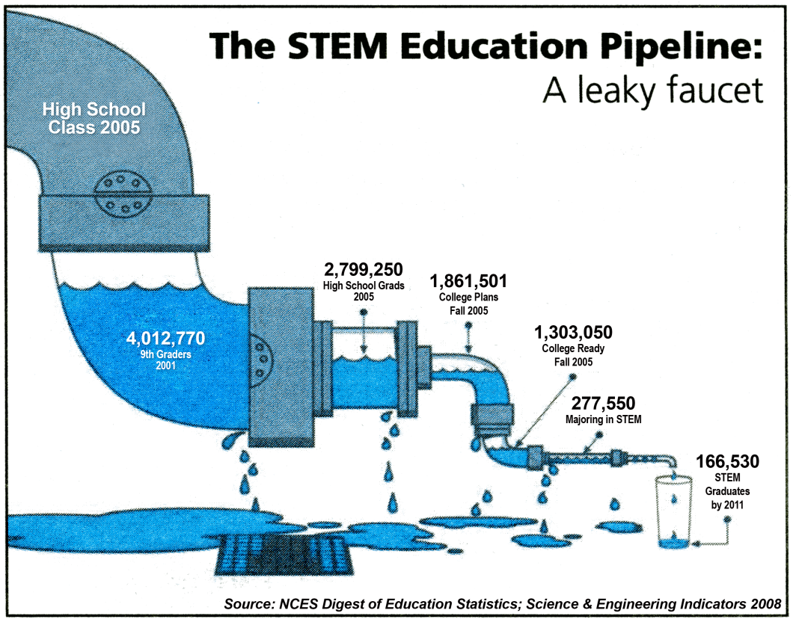
Army Leaders Rely on our STEM Capabilities
“Today, more than ever before, science holds the key to our survival as a planet and our security and prosperity as a nation. It's time we once again put science at the top of our agenda and work to restore America's place as the world leader in science and technology.'
-- President Barack Obama
The Army is investing in STEM to achieve success
The Army now requires all incoming ROTC officers to have a STEM-oriented degree.
The U.S. Army annually grants more than $250 million in ROTC scholarships.
Numerous Army posts are dedicated to scientific research and improving the Army’s technical capabilities, e.g., Aberdeen Proving Grounds, MD; Redstone Arsenal, AL, Natick Army Research Laboratories, MA.
The Army’s undergraduate engineering program at West Point continues to be one of the best engineering schools in the nation.
The Army has numerous STEM-related career fields for both officers and enlistees, e.g., Environmental Science/Engineering Officer (72D), Clinical Laboratory Scientist (71E), Enlisted Computer/Detection Systems Repairer (94F), Information Technology Specialist (25B), Satellite Communication Systems Operator-Maintainer (25S), Test Measurement and Diagnostic Equipment Maintenance Support Specialist (94H)
How is the Army attracting tomorrow’s STEM leaders?
Through the development and integration of non-kinetic, hi-tech recruiting and education assets, the Army can help mitigate the national STEM crisis by appealing to an increasingly technical target demographic audience, increasing access to historically hard-to-reach schools, increasing the output of qualified, experienced leaders that are trained and equipped to be successful in today’s technology-dependent society.
Notes:
Jobs requiring STEM degrees are projected to increase four times as fast as overall job growth. Many job openings will not be filled by United States citizens (BHEF 2005). Foreign STEM graduates are working less in the United States due to increased immigration regulations and increased resources in their countries of origin.
K-12 students from the United States perform below students from other industrialized countries on international tests of math and science. In the report issued Dec. 4, 2007 by the Organization for Economic Cooperation and Development, the US was classified as “statistically below OECD average” in both science knowledge and mathematics in the 2006 PISA survey of 400,000 15-y.o. students in 57 countries!
Within the U.S., there is an achievement gap between under-represented minority students and majority students at a time when underrepresented groups are becoming an increasing proportion of the national labor force.
Less than 40% of students intending to major in STEM fields upon college entrance actually complete a degree in these fields. For underrepresented minorities the rate is below 25%.
Internationally the US has far fewer STEM graduates compared to other industrialized countries.
U.S. advantages in the marketplace and in science and technology have begun to erode. A comprehensive and coordinated federal effort is urgently needed to bolster U.S. competitiveness and pre-eminence in these areas. [We make] four recommendations along with 20 implementation actions that federal policy-makers should take to create high-quality jobs and focus new science and technology efforts on meeting the nation's needs, especially in the area of clean, affordable energy: 1) Increase America's talent pool by vastly improving K-12 mathematics and science education; 2) Sustain and strengthen the nation's commitment to long-term basic research; 3) Develop, recruit, and retain top students, scientists, and engineers from both the U.S. and abroad; 4) Ensure that the United States is the premier place in the world for innovation. The 2007 report Rising above the Gathering Storm: Energizing and Employing America for a Brighter Economic Future
Based on US projections of 280,000 new math and science teachers needed by 2015, it recommends a coordinated reform effort involving the federal and state governments, school districts, higher education, business and foundations. Specifically, it states that, “it is critical for the business community and higher education to become more actively engaged in efforts to improve mathematics and science teaching. BHEF calls on leaders from these two groups to influence, energize, and drive change.” Business-Higher Education Forum , An American Imperative: Transforming the Recruitment, Retention & Renewal of Our Nation’s Mathematics and Science Teaching Workforce in 2008
http://www.usatoday.com/news/education/2010-02-24-millennials24_ST_N.htm

Slide 5
Officer Career Timeline
 | Years | 1 - 2 | 3 - 9 | 10 - 16 | 17 - 21 | 22 - 30
Rank |  | 2nd / 1st Lieutenant | Captain | Major | Lieutenant Colonel | Colonel
PROFESSIONAL KEY DEVELOPMENTAL/ BROADENING ASSIGNMENTS |  | Typically the entry-level rank for most Officers. Leads platoon-size elements consisting of the platoon SGT and two or more squads (16 to 44 Soldiers). As a senior Lieutenant, they are often selected to be the Executive Officer of a company-sized unit (110 to 140 personnel). | Commands and controls company-sized units (62 to 190 Soldiers). Instructs skills at service schools and combat training centers and is often a Staff Officer at the battalion level. | Serves as primary Staff Officer for brigade and task force command regarding personnel, logistical and operational missions. | Typically commands battalion-sized units (300 to 1,000 Soldiers). May also be selected for brigade and task force Executive Officer. | Typically commands brigade-sized units (3,000 to 5,000 Soldiers), with a CSM as principal NCO assistant. Also found as the chief of divisional-level staff agencies.
Civilian Education |  | Bachelors Degree | Graduate Degree (s)
Professional Military Education |  | BOLC | CCC | ILE | SSC
Training
Self Development |  | Professional Certification
Advanced Civilian Schooling/Training with Industry
Ranger, Airborne, Air Assault Schools

Slide 6
Enlisted and NCO Career Timeline
 | Years | 1 - 3 | 3 - 6 | 7 - 11 | 12 - 16 | 17 - 21 | 22 – 30
Rank |  | Private/Private First Class/Specialist | Corporal/ Sergeant | Staff Sergeant | Sergeant First Class | Master Sergeant/1st SGT | Sergeant Major/ Command/CSM
PROFESSIONAL KEY DEVELOPMENTAL/ BROADENING ASSIGNMENTS |  | Manages other enlisted Soldiers of lower rank. Has served a minimum of two years and attended a specific training class to earn this promotion. People enlisting with a four year college degree can enter BCT as a Specialist. | Typically commands a squad (9 to 10 Soldiers). Considered to have the greatest impact on Soldiers because SGTs oversee them in their daily tasks. | Also commands a squad (9 to 10 Soldiers). Often has one or more SGTs under their leadership. Responsible for developing, maintaining and utilizing the full range of his Soldiers' potential. | Key assistant and advisor to the platoon leader. Makes quick, accurate decisions in the best interests of the Soldiers and the country | Principal NCO at the battalion level, and often higher. Can be charged with all the leadership responsibilities of a 1SG,principal NCO and life-blood of the company: the provider, disciplinarian and wise counselor. Instructs other SGTs, advises the Commander and helps train all enlisted Soldiers. Assists Officers at the company level (62 to 190 Soldiers). | Enlisted advisors to the commanding officer. They carry out policies and standards, and advise the commander on the performance, training, appearance, and conduct of enlisted soldiers. The CSM's counsel is expected to be calm, settled and unequivocally accurate, but with an energy and enthusiasm that never wanes, even in the worst of times
Civilian Education |  | AA/AAS Degree |  |  | Bachelors Degree/Masters Degree
Professional Military Education |  | WLC | ALC | SLC |  | FSC | SMA
Training
Self Development |  | Professional Certification
Battle Staff Course
Ranger, Airborne, Air Assault Schools

Slide 7
Success After the Army
PARTNERSHIP FOR YOUTH SUCCESS (PAYS)
The PaYS Program is a partnership between the U.S. Army and a cross section of American corporations and public sector agencies. PaYs provides an opportunity to serve while simultaneously preparing for the future. Soldiers and ROTC cadets are guaranteed a job interview and possible employment with a PaYS partner of their choice.
Qualified applicants select an employment opportunity with a PaYS partner upon separation from active duty or completion of Army Reserve Initial Entry or ROTC training.
Here are a few examples of the more than 460 PaYS partners:
Union Pacific Railroad
Cintas
Amazon.com
John Deere
Sears
Southwest Airlines
Cisco Systems
Walgreens
Waste Management, Inc.
Kraft
JB Hunt USAA
Hyundai Motor America
Best Buy
Soldiers receive the finest training, develop valuable skills and gain experience in a broad spectrum of Army jobs. Soldiers are motivated, have professional work habits and high standards of conduct. The Army’s PaYS partners value the skills individuals with a military background bring to the workplace.

